Slide 1
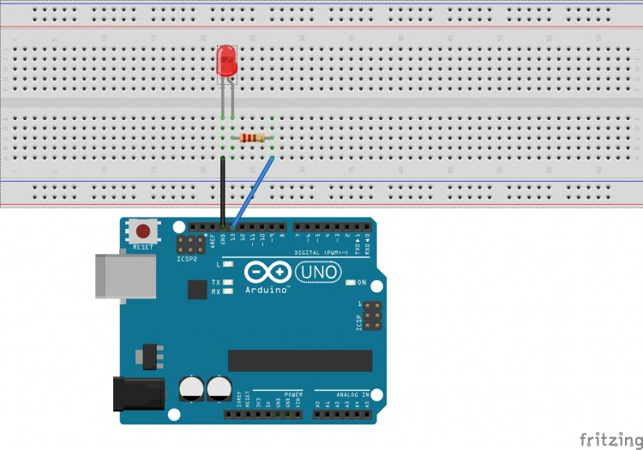
Lesson 1 – Led Blink

Slide 2
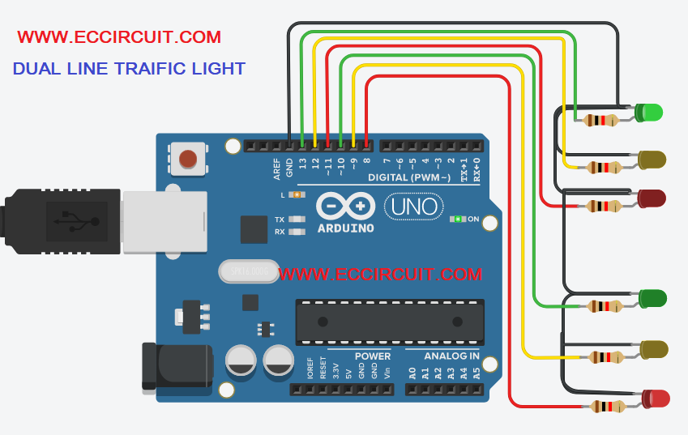
Lesson 1.3 – Traffic Light

Slide 3
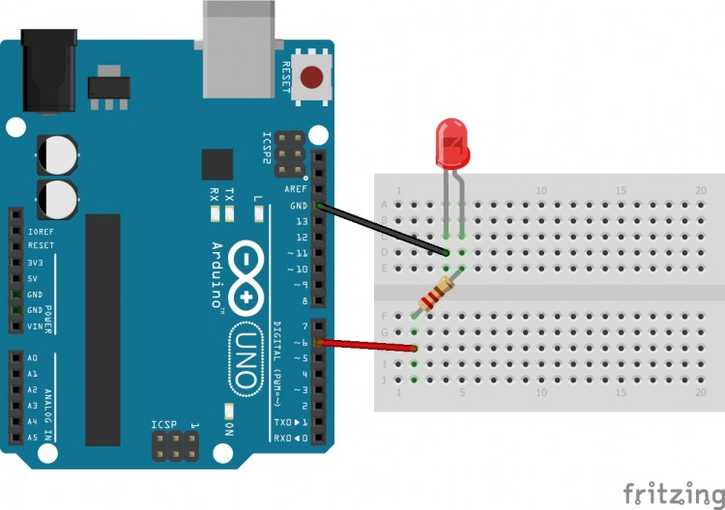
Lesson 2 – Led Bright Gradually

Slide 4
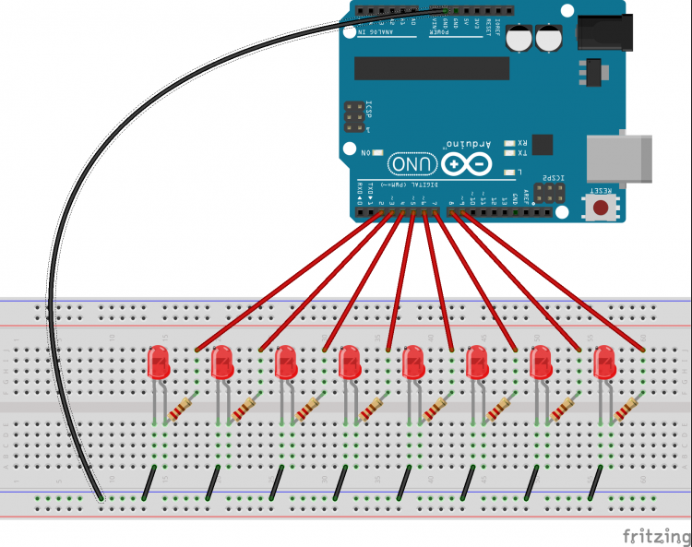
Lesson 3 - Arrays of 8 LEDs

Slide 5
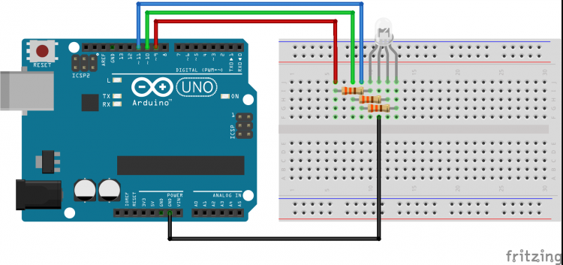
Lesson 4 - RGB LED

Slide 6
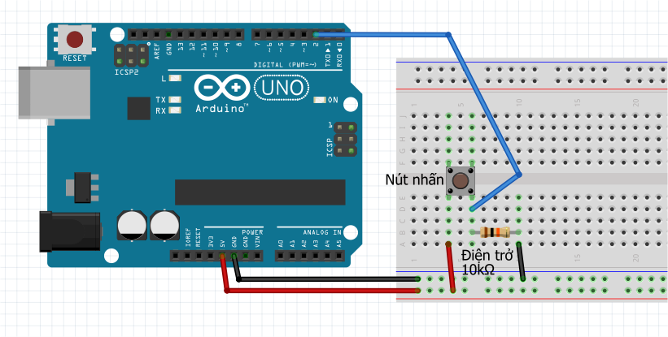
Lesson 5 – Button Status

Slide 7
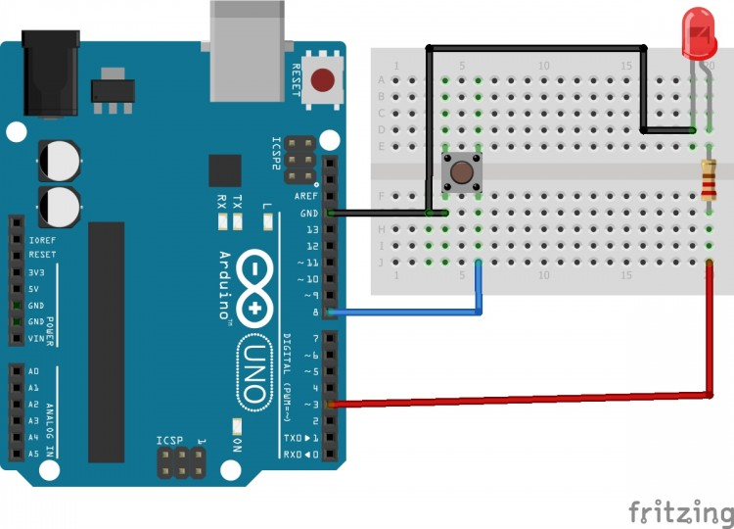
Lesson 5.1 - Button Control LED (INPUT_PULLUP)

Slide 8
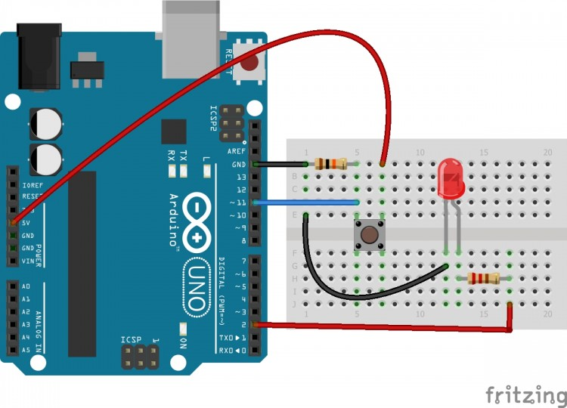
Lesson 5.2 - Button Control LED (INPUT)

Slide 9
Lesson 5.3 – Count pressing button times

Slide 10
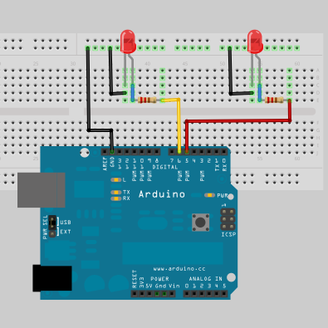
Lesson 6 – Blink LED without DELAY(using millis())

Slide 11
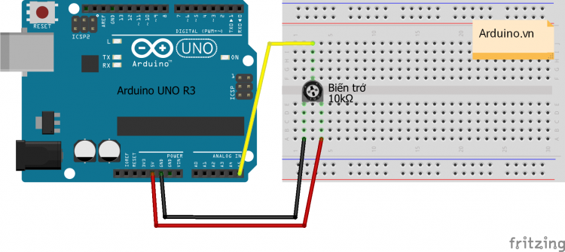
Lesson 7&7.1 – Using potentiometer to read resistance and voltage

Slide 12
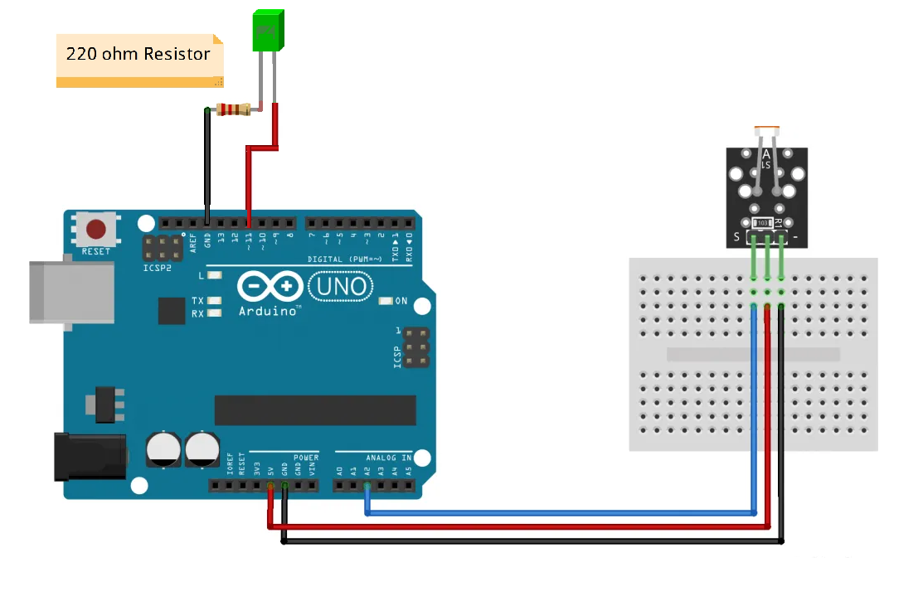
Lesson 9 – Using photoresistor in LED Brightness controll

Slide 13
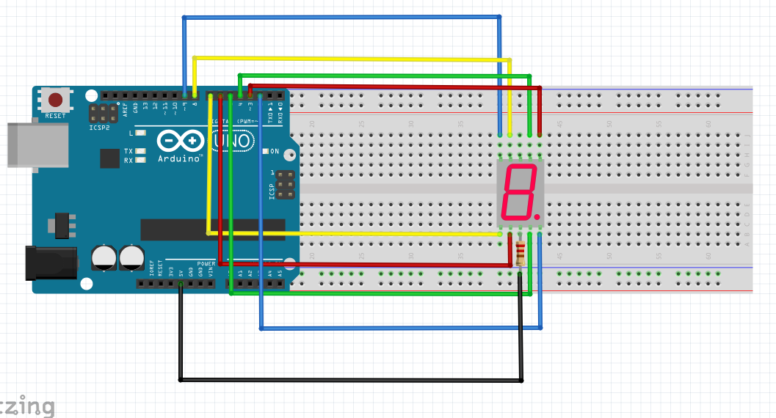
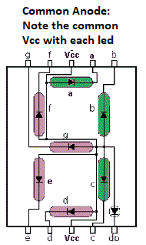
Lesson 10_ LED 7 Segments 1 Digit (COMMON ANODE +)
1K Ohm resistance

Slide 14
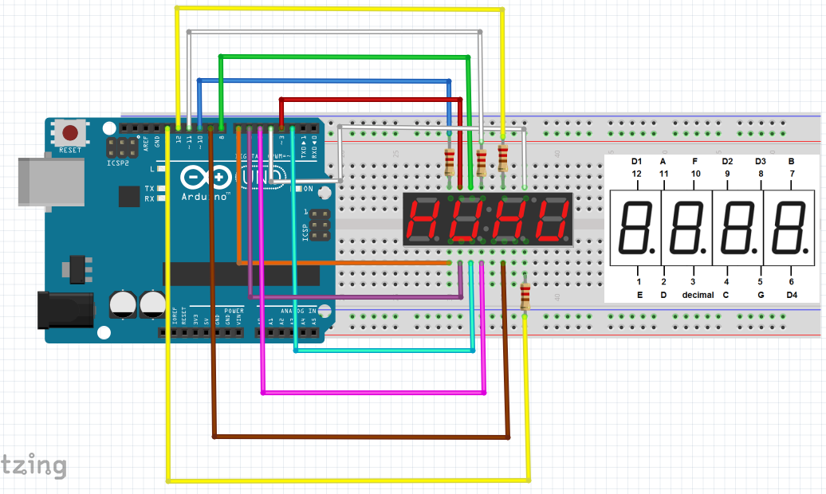
Lesson 11_ LED 7 Segments 4 Digit (COMMON ANODE +)
1K Ohm resistance

Slide 15
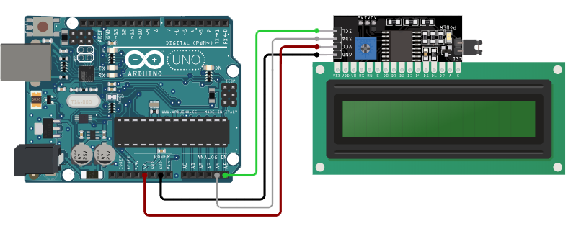
Lesson 12_ LCD1602 with I2C module

Slide 16
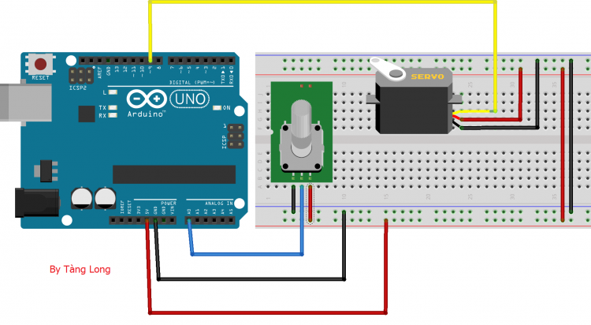
Lesson 13_ Servo Knob with Potentiometer

Slide 17
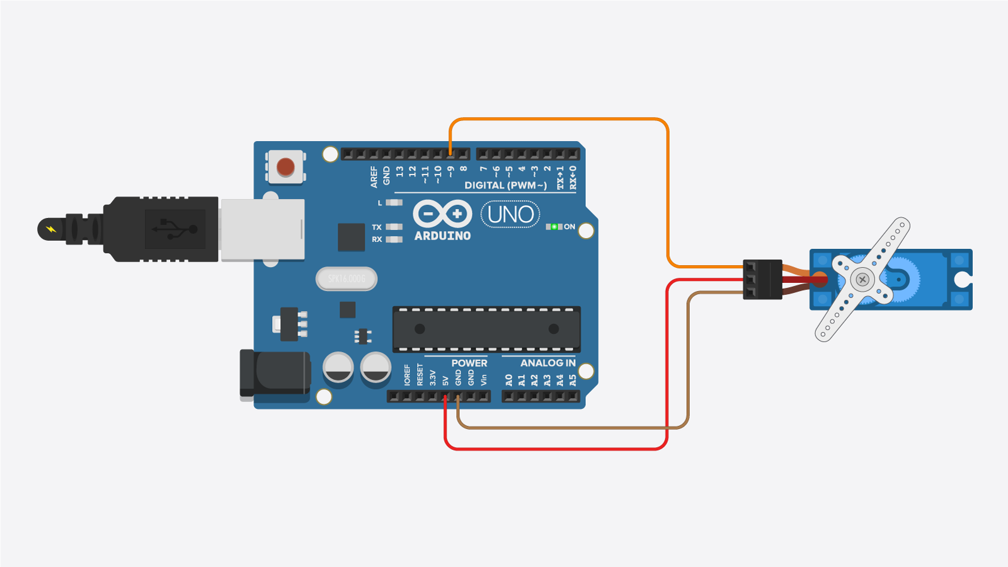
Lesson 13.1_ Servo Sweep 180 Degree

Slide 18
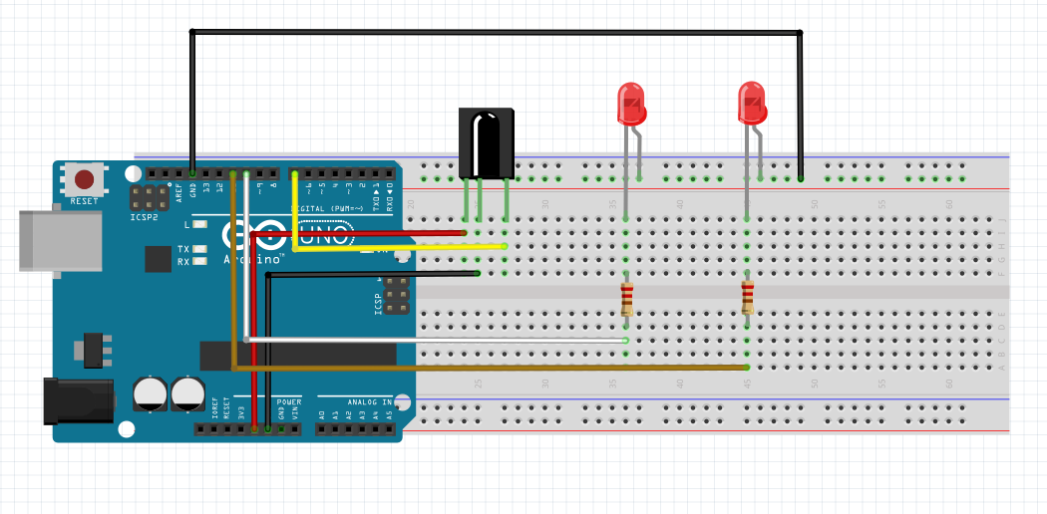
Lesson 14_ IR Remote Control

Slide 19
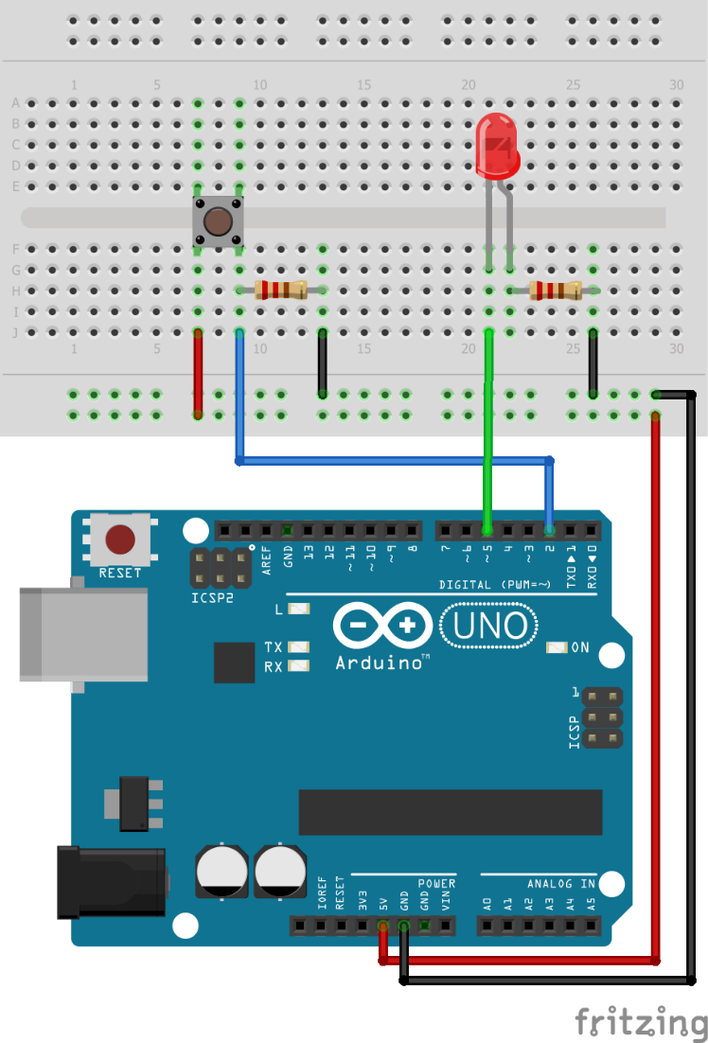
Lesson 16_ External Interrupt

Slide 20
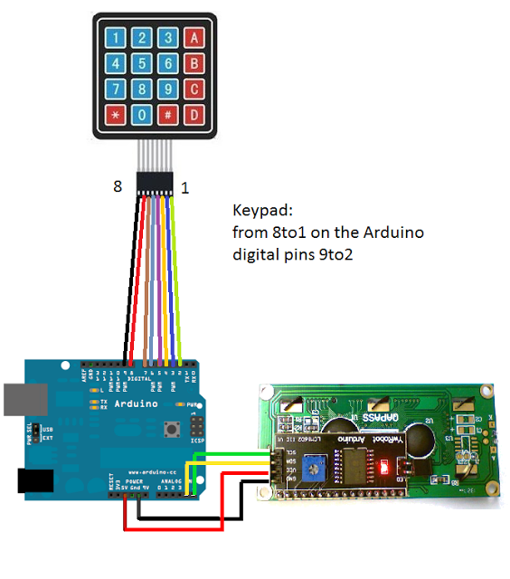
Lesson 17_ Introducing KeyPad 4x4

Slide 21
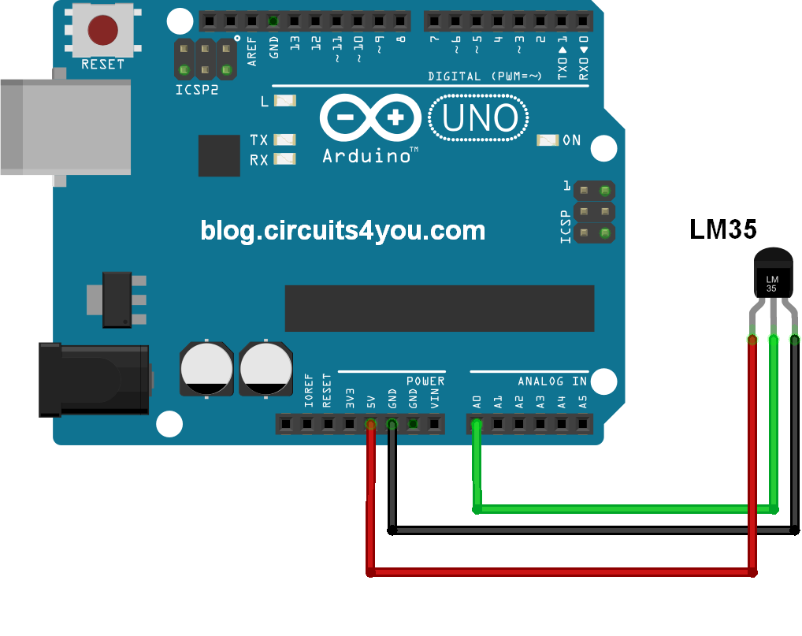
Lesson 18 – LM35D Temperature Sensor

Slide 22
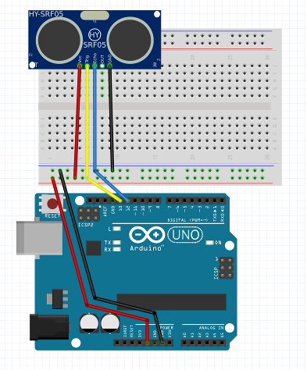
Lesson 19 – Ultrasonic sensor

Slide 23
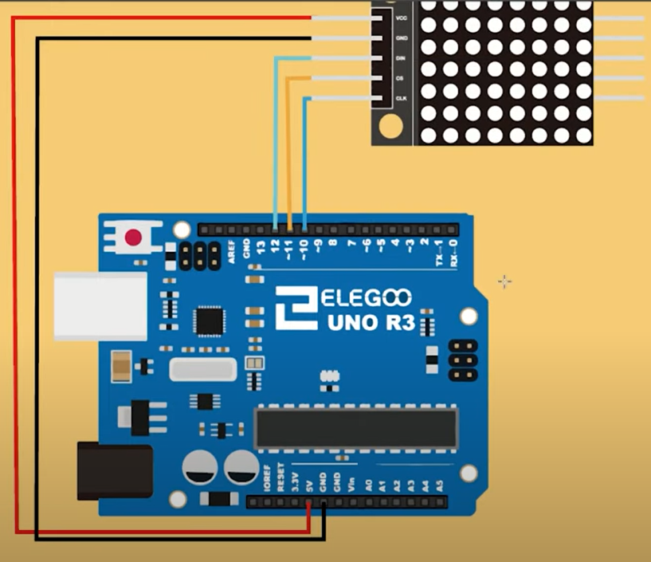
Lesson 20 – LED matrix 8x8 with MAX7219 module

